Slide 3
Introduction to SharePoint Framework (SPFx)

Slide 4
Agenda
Introducing SharePoint Framework (SPFx)
SPFx Toolchain
SPFx Webpart
Deploy SPFx WebPart
Q&A

Slide 5
SharePoint Development Models
2001
ASP Classic
2003
Web parts (ASP.Net custom controls)
Packaged in CAB
2007
Features
WSP package
2010
Timer jobs
Sandbox
2013 / 2016
SharePoint hosted addins
Provider hosted add-ins
JSLink / CSR
SPO
SharePoint hosted addins
Provider hosted add-ins
JSLink / CSR
No code sandbox solutions
SharePoint Framework (SPFx)

Slide 6
What is SPFx?
“The SharePoint Framework (SPFx) is a page and web part model that provides full support for client-side SharePoint development, easy integration with SharePoint data, and support for open source tooling.”

Slide 7
Why the SharePoint Framework?
SharePoint was launched as an on-premises product in 2001 including:
Web arts, SharePoint feature XML, and more. Many features were written in C#, compiled to DLLs, and deployed to on-premises farms.

Slide 8
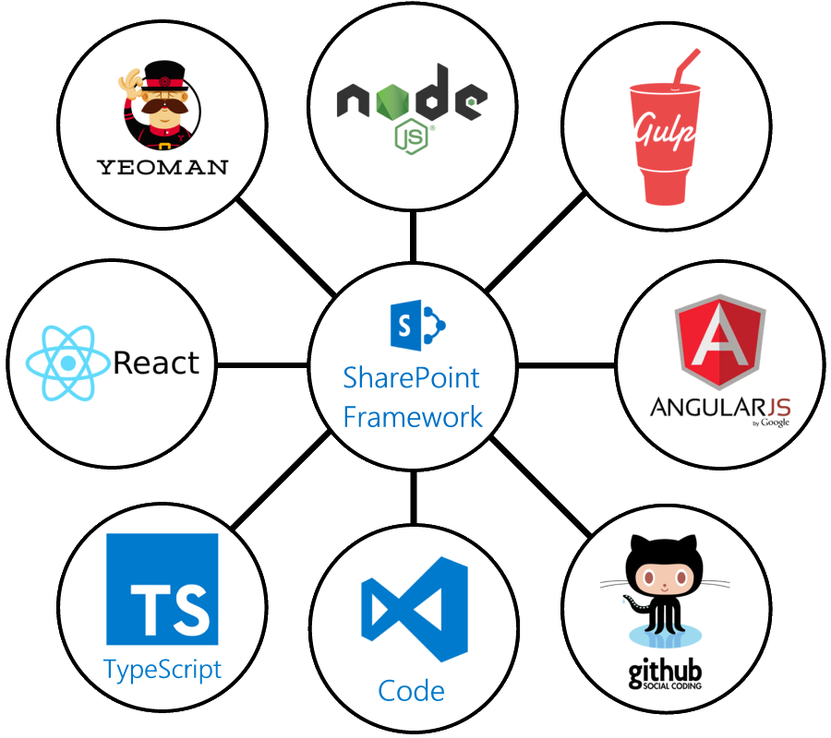
SPFx principles
It runs in the context of the current user and connection in the browser.
There are no iFrames for the customization (JavaScript is embedded directly to the page).
The controls are rendered in the normal page DOM.
The controls are responsive and accessible by nature.
It is framework-agnostic. You can use any JavaScript framework that you like: React, Handlebars, Knockout, Angular, and more.
The toolchain is based on common open source client development tools such as npm, TypeScript, Yeoman, webpack, and gulp.
SPFx web parts can be added to both classic and modern pages.

Slide 9




TOOLCHAIN COMPARISON
IIS Express
MS Build
VS Project →
New → <Template>
C#
Notes:
NodeJS = IIS (Express)
Npm = Package Manager
Gulp = MSBuild
YeoMan = project scafolding in VS
TypeScript= typed superset of JavaScript

Slide 10
SPFx DEVELOPMENT ENVIRONMENT
Use any most OS / workstation
Office 365 / SharePoint Online tenant
App catalog for deployment
Install nodeJS (current Long Term Support (LTS) version)
Yeoman and Gulp
C:\> npm i –g yo gulp
SPFx Yeoman generator
C:\> npm i –g @microsoft/generator-sharepoint
C:\> npm update –g @microsoft/generator-sharepoint
Use code editor
VS Code / Sublime Text / NotePad++, etc
Notes:
SharePoint Tenant
App Catalog
NodeJs
Npm
Gulp
Yeoman
Visual Studio Code

Slide 11
CREATE YOUR FIRST SPFx WEBPART
C:\> md helloworld-webpart
C:\> cd helloworld-webpart
C:\> yo @microsoft/sharepoint
Working on it… ☺
You can execute yo command again to add more webparts to project
Generate local Trust Cert & Serve
C:\> gulp trust-dev-cert
C:\> gulp serve
Check out your first WebPart!
May also load in SPO workbench: “../_layouts/15/workbench.aspx”
Notes:
Create our first SPFx webpart
md helloworld-webpart
cd helloworld-webpart
yo @microsoft/sharepoint
gulp serve
../_layouts/15/workbench.aspx
Now open workbench in dev tenant, while local gulp is running

Slide 12
SPFx PROJECT FOLDER OVERVIEW
Get to know your Webpart folder structure
src: primary webpart TypeScript source code
config: json configuration files for build process
typings: TypeScript typings for JS libs – legacy
lib: Build files (TS compiled JS) ready for bundle
dist: Final web ready code for distribution
sharepoint: .spapp file for App Catalog
node_modules: NodeJS modules (JS) for toolchain

Slide 13
PACKAGE YOUR WEBPART FOR DEPLOY
Set deployment configuration
config/package-solution.json – general settings and package name
write-manifests.json – CDN / bundle location – for dev, can serve locally: gulp serve --nobrowser
C:\> gulp clean (cleans sharepoint and temp folders)
C:\> gulp build (Rebuilds the solution)
C:\> gulp bundle (Creates the solution bundles)
C:\> gulp package-solution (Creates /sharepoint/”webpart”.spapp)
C:\> gulp –ship (minifies bundle and reads in CDN info from config/write-manifests.json)
C:\> gulp package-solution --ship (Recreates /sharepoint/”webpart”.spapp with CDN info)

Slide 14
PACKAGE YOUR WEBPART FOR DEPLOY
After solution created, can then add to SharePoint
Add .spapp to app catalog
Add Add-In to SharePoint site
Add WebPart in site to content page
Configure CDN
Office 365 CDN: https://docs.microsoft.com/en-us/sharepoint/dev/spfx/web-parts/get-started/hosting-webpart-from-office-365-cdn
Azure CDN: https://dev.office.com/sharepoint/docs/spfx/web-parts/get-started/deploy-web-part-to-cdn
Or manually deploy solution bundle and config write-manifests.json

